Slide 1

BMS COLLEGE OF ENGINEERING
(Autonomous Institute, Affiliated to VTU, Belagavi)
DEPARTMENT OF MACHINE LEARNING
(UG Program: B.E. in Artificial Intelligence and Machine Learning)
Course : Project Work on Machine learning
Course Code: 22AM5PWPML
MUSIC GENRE CLASSIFICATION
Phase - 2 Presentation
Date: 9th Feb, 2023
Presented By,
Student Name & USN :
Abhishek S Kerenor (1BM20AI001)
Ashish D D (1BM20AI015)
M Srihari (1BM20AI035)
Vivek Jain (1BM20AI061)
Faculty In-Charge:
Dr. Gowrishankar
Professor and Head
Department of Machine Learning
BMS College of Engineering
Semester & Section: 5A
Batch Number:

Slide 2


MUSIC GENRE CLASSIFICATION

Slide 3


Agenda
Introduction
Literature Review
Open Issues
Problem Statement
Proposed Methodology
Functional & Non-Functional Requirements
Testing and Validation
Progress in Project so far
Expected Outcome
Conclusion
References
.
02
03

Slide 4

Introduction
Music genre classification is the task of assigning a genre label to a piece of music. Genres are categories that describe the style or content of a piece of music, and they can be used to organize music collections and facilitate music discovery. Some examples of music genres include rock, pop, hip hop, electronic, and classical.
There are many approaches to genre classification, ranging from simple rule-based systems to more complex machine learning models. In general, the process of genre classification involves extracting features from a piece of music, such as the lyrics, instrumentation, and tempo, and then using those features to predict the genre label.

Slide 5




Slide 6
AUTHOR / TITLE / YEAR | APPLIED METHODOLOGY / ALGORITHM USED | FINDINGS | RESULTS | LIMITATIONS
[1] Lee, D., & Kim, J. (2008). Music genre classification using support vector machines. Expert Systems with Applications, 35(4), 1450-1454. | SVM, (SUPPORT VECTOR MACHINE) | They found than using MFCC features alone resulted in slightly better performance than Using all of the features. | SVM classifier achieved an overall classification accuracy of about 85% on their dataset. | One limitation of this study is that the authors only evaluated the SVM classifier on a single dataset. So it is not clear how well it compares to other approaches to music genre classification.
[2] Music Genre Classification and Recommendation by Using Machine Learning Techniques, Ahmet Elbir Nizamettin Aydin, (2018) Innovations in Intelligent Systems and Applications Conference (ASYU) | RANDOM FOREST | They found that using MFCC features alone resulted in slightly better performance than using all of the features together. | Random forest classifier achieved the highest classification accuracy, with an average accuracy of about 83%. | One limitation of this study is that the authors only evaluated the machine learning models on a single dataset. So ,it is not clear how well the models compare to other approaches to music genre classification
[3] Polato, M., & Carvalho, E. (2016). Music genre classification using random forests. In Proceedings of the 23rd International Conference on Pattern Recognition (pp. 3155-3160). | RANDOM FOREST | They found that combination of all three features resulted in the best performance, with an accuracy of about 92%. | Random forest classifier achieved an overall classification accuracy of about 86% on their dataset. | One limitation of this study is that the authors only evaluated the random forest classifier on a single dataset, so it is not clear how well the classifier would generalize to other datasets.
[4] Jannach, D., & Zanker, M. (2004). Music genre classification using decision trees. In Proceedings of the 2nd International Conference on Music Information Retrieval (pp. 227-232). | DECISION TREE | They found that the combination of all 3 feature types resulted in the best performance, accuracy of about 85%. | Decision tree classifier achieved an overall classification accuracy of about 80% on their dataset | One limitation of this study is that the authors only evaluated the decision tree classifier on a single dataset, so it is not clear how well the classifier would generalize to other datasets
[5] Improve Music Genre Classification with Conv Nets, Rafael L. Aguiar ; Yandre M.G. Costa ; Carlos (2012). | CNN | They also found that the best results were obtained using a convolutional layers and a fully connected layer. | ConvNets achieved an classification accuracy of 80% on their dataset. | One limitation of this study is that the authors only evaluated the it on a single dataset, so it is not clear how well it would generalize to other datasets.

Slide 7
AUTHOR / TITLE / YEAR | APPLIED METHODOLOGY / ALGORITHM USED | FINDINGS | RESULTS | LIMITATIONS
[6] Hareesh Bahuleyan. Music genre classification using machine learning techniques. CoRR, abs/1804.01149 , 2018. | FEATURE EXTRACTION | Spectral features and rhythm features resulted in slightly better performance than using spectral features alone. | Average accuracy of about 70% across all genres using a combination of spectral features. | One limitation of this study is that the author did not compare the performance of the ml models to more advanced techniques, such as CNN.
[7] A N-Gram Based Musicological Approach, Eve Zheng ; Melody Moh ; Teng- Sheng Moh, 2017 IEEE 7th International Advance Computing Conference | K-NEAREST NEIGHBORS | They also found that using 2-grams and 3 grams resulted in slightly better performance than using 1-grams alone. | An average accuracy of about 70% across all genres. | One limitation of this study is that the authors only evaluated the machine learning models on a single dataset.
[8] F. Pedregosa, G. Varoquaux, A. Gramfort, V. Michel, B. Thirion, and E. Duchesnay. Scikit-learn: Machine learning in Python. Journal of Machine Learning Research, 12:2825–2830, 2011. | SCIKIT-LEARN | Scikit-learn includes a number of algorithms for classification, including support vector machines, logistic regression, and decision trees. | It also includes a range of tools for preprocessing data, such as imputation of missing values and scaling of features. | One potential limitation of scikit learn is that it is not as flexible as some other machine learning libraries and may not be suitable for more advanced or specialized tasks.
[9] Pons, J., & Serra, X. (2016). Automatic music genre classification using convolutional neural networks. arXiv preprint arXiv:1608.04363 | CNN | They also found that the best results were obtained using ConvNet with five convolutional layers and 2 fully connected layers. | The authors found that the ConvNets achieved an overall classification accuracy of about 75% on their dataset. | One limitation of this study is that the authors only evaluated it on a single dataset, so it is not clear how well the it would generalize to other datasets.
[10] Changsheng Xu, Namunu C Maddage, Xi Shao, Fang Cao, Qi Tian2003 IEEE International Conference on Acoustics, Speech, and Signal Processing Proceedings.(ICASSP'03). 5, V-429, (2003). | SVM (SUPPORT VECTOR MACHINE) | They found than using MFCC features alone resulted in slightly better performance than Using all of the features. | SVM classifier achieved an overall classification accuracy of about 82% on their dataset. | One limitation of this study is that the authors only evaluated the SVM classifier on a single dataset. So it is not clear how well it compares to other approaches to music genre classification.

Slide 8

Open Issues
Data imbalance: Depending on the dataset, some genres may be underrepresented, which can make it difficult for the model to accurately classify those genres.
Feature selection: There may be a large number of features available for each music sample, and not all of them may be relevant for genre classification.
Model performance: The model's performance may not be as good as desired, particularly if the dataset is small or the music genres are highly diverse.
Deployment: To deploy the model as a service, then it needs to consider issues such as scalability, reliability, and security.

Slide 9

Problem Statement
The Genre of the song is one of the main category to classify millions of songs. There are handful of genres that categorize the songs. To the current generation and to the upcoming, a futuristic model that brings out better classification of the songs in music industry has to be built with the most efficient techniques and algorithms we have in today’s world.
To produce a model based on machine Learning that solves the challenge of automatic classification of songs into it’s corresponding genre.
To bring a better accuracy rate in the produced model/project as compared to the early attempts and pre-existing models.
With the fast growing technologies of Machine Learning, a useful model to the Entertainment industry has to be built.

Slide 10

Proposed Methodology
Gather a dataset of music samples and their corresponding genre labels.
Preprocess the data by converting the music samples into a format that can be input to a machine learning model.
Split the dataset into a training set and a test set.
Choose a machine learning model and train it on the training set.
Fine-tune the model's hyperparameters to optimize its performance.
Evaluate the model's performance on the test set and analyze the results.
Deploy the model and use it to classify new pieces of music.
Monitor the model's performance over time and make updates as needed.

Slide 11

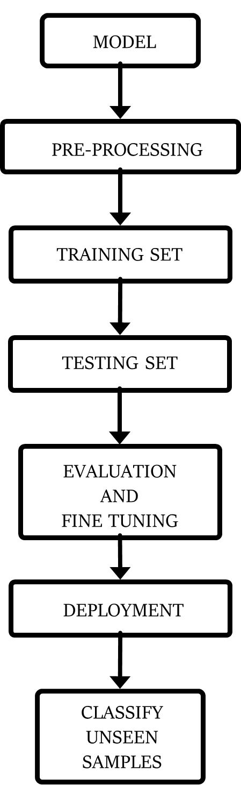
Proposed Methodology
Machine learning model:
K-means clustering
K-nearest neighbors
Convolutional neural networks
GTZAN (Data sets)

Slide 12

Functional Requirements
The system should be able to classify a piece of music into one or more genres.
The system should be able to accept music samples in a variety of formats (e.g., MP3, WAV, FLAC).
The system should provide an interface (e.g., a web application or API) for submitting music samples and receiving genre predictions.
The system should support multiple languages (e.g., English, Spanish, French).
The system should allow users to specify a level of confidence for each genre prediction (e.g., "high," "medium," "low").

Slide 13

Non-Functional Requirements
The system should have an accuracy rate of at least 80% for genre classification.
The system should be able to classify music samples in real-time (e.g., within a few seconds).
The system should be scalable to handle a large volume of classification requests.
The system should be reliable and available 99% of the time.
The system should be secure, with appropriate safeguards in place to protect against data breaches or unauthorized access.

Slide 14
Testing and Validation
TEST CASE | GIVEN INPUT | EXPECTED OUTPUT (Genre) | OBTAINED OUTPUT (Genre)
1. | Sample Music 1 | Country | Country
2. | Sample Music 5 | Hip hop | Hip hop
3. | Sample Music 9 | Classical | Classical
4. | Sample Music 15 | Disco | Disco

Slide 15

Expected Outcome
We have used various techniques for selecting the best hyper parameters depending upon the best technique for that particular algorithm.
Confusion matrices are our visual to measure the performance of the best model as the genres are uniformly distributed through our dataset.
Accuracy of different models
 | Model | Expected | Obtained
1. | K-Nearest Neighbour(K-NN) | 60.4% | 71.35%
2. | CNN | 70% | 92.93%

Slide 16
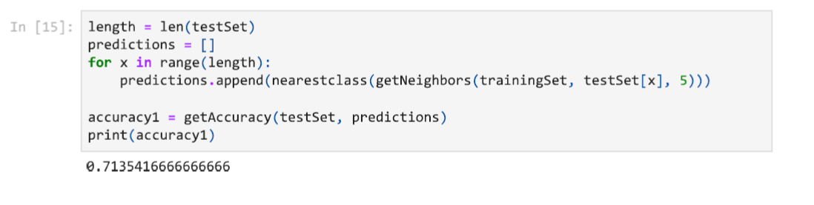
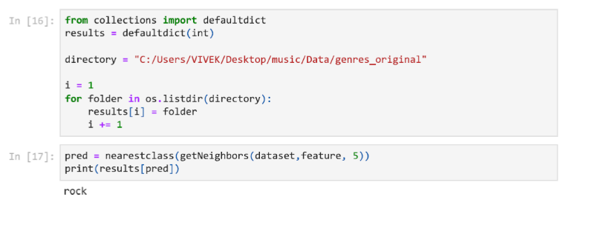
Results
For KNN model:

Slide 17
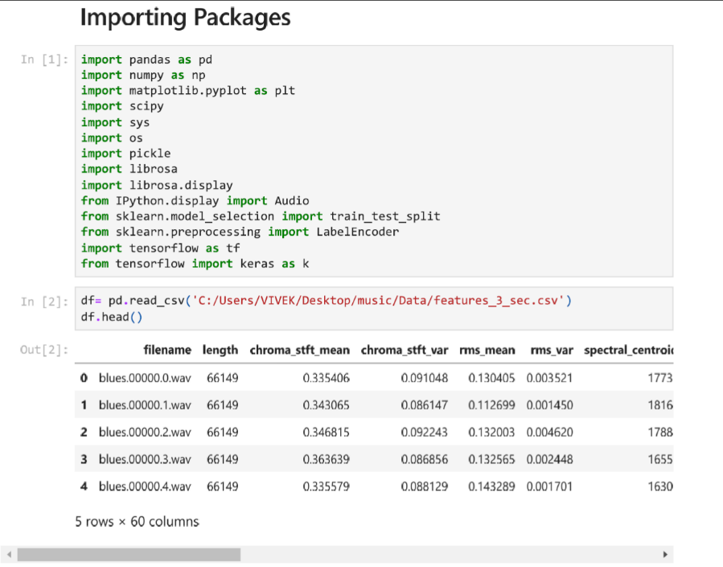
Result
For CNN Model:

Slide 18
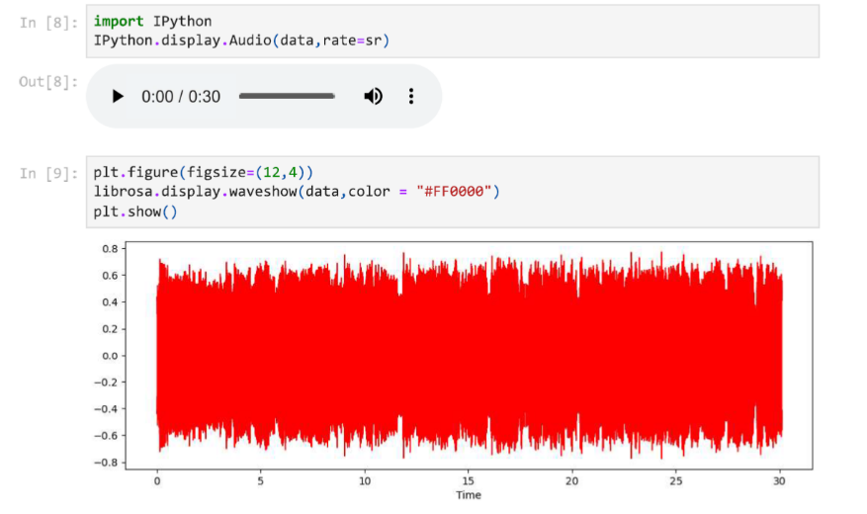
Result
Plot of Raw wave :
Country

Slide 19
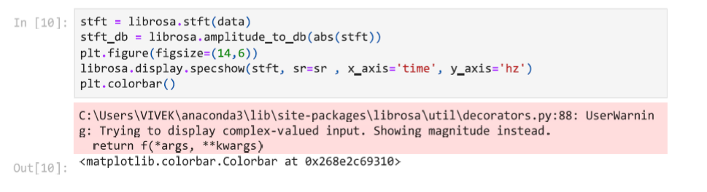
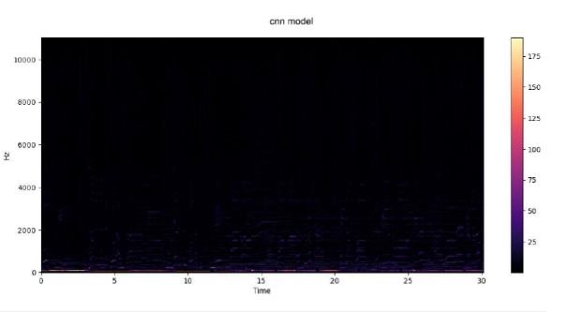
Result
Spectrogram color bar:

Slide 20
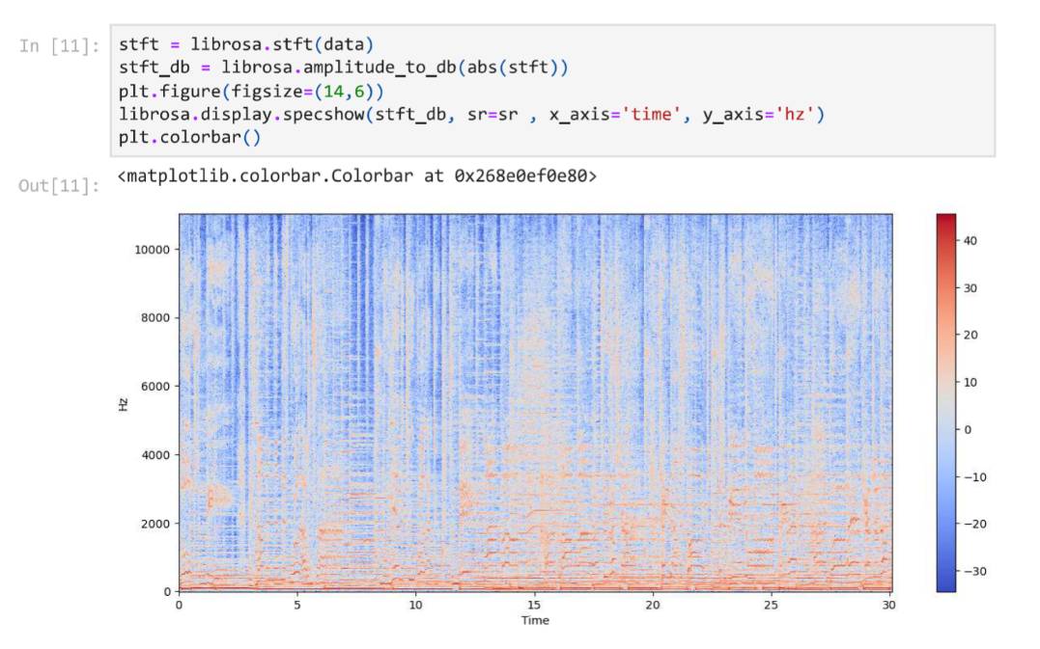
Result
Spectrogram :

Slide 21

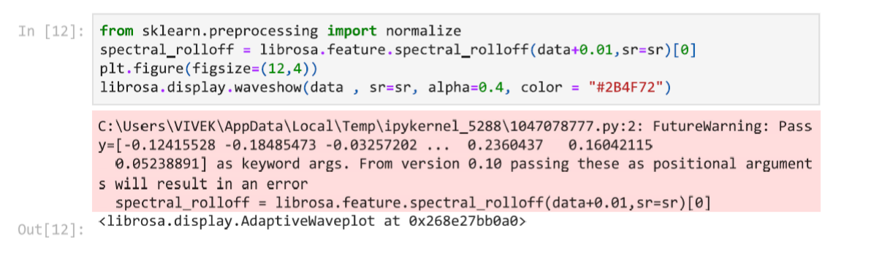
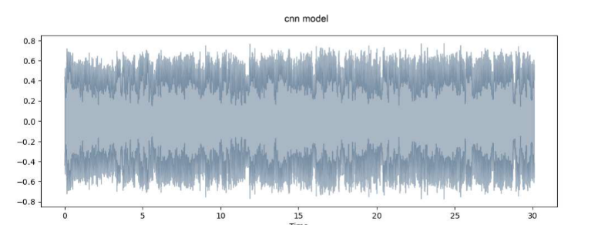
Result

Slide 22
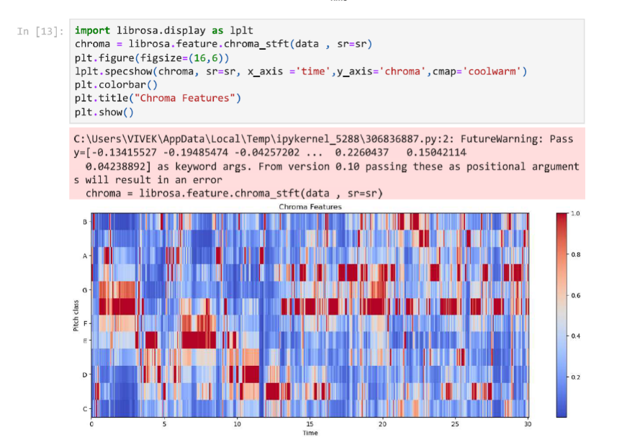
Result
Chroma Feature:

Slide 23
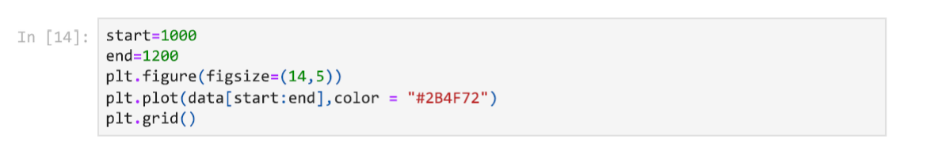
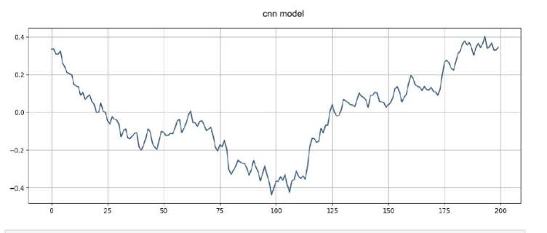
Result
Zero Crossing Rate:

Slide 24
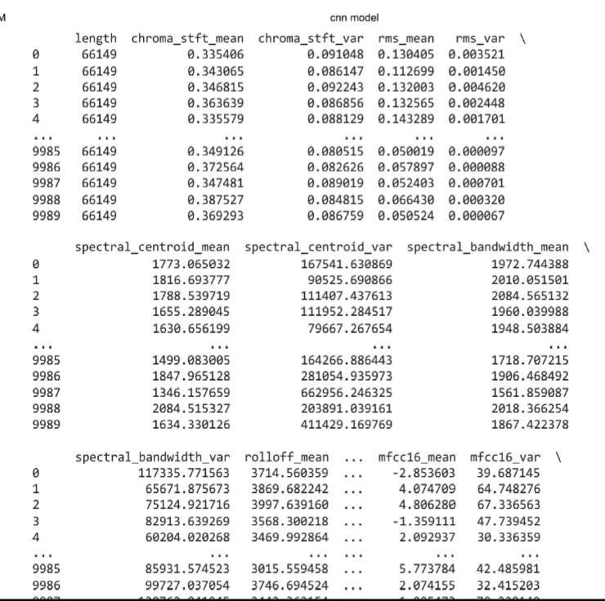
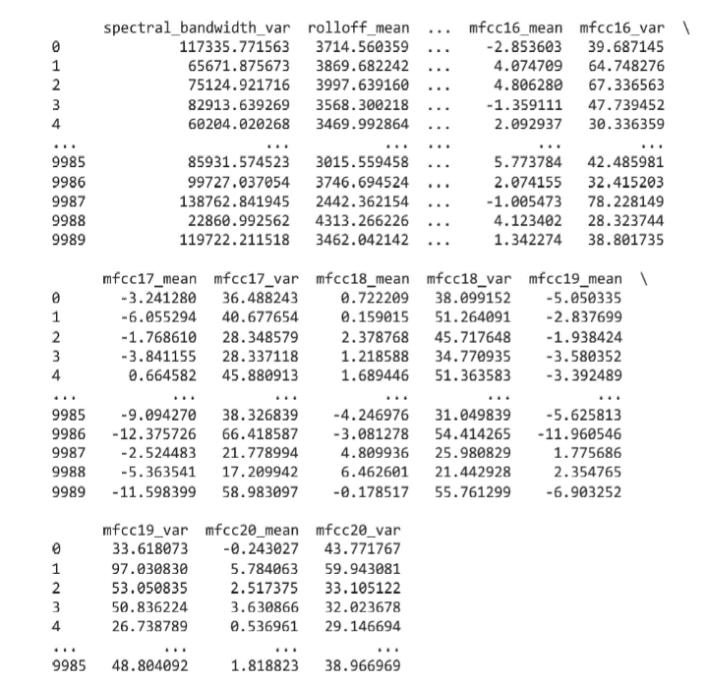
Result
Feature Extraction:

Slide 25
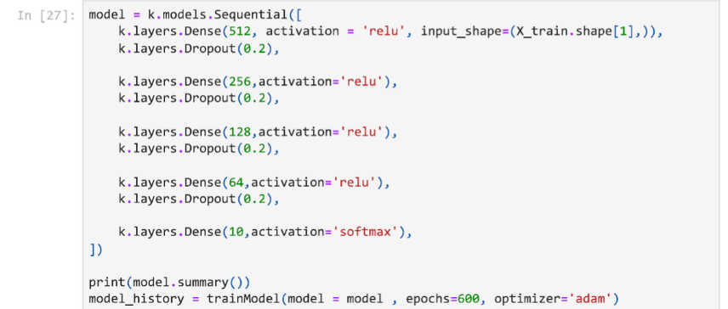
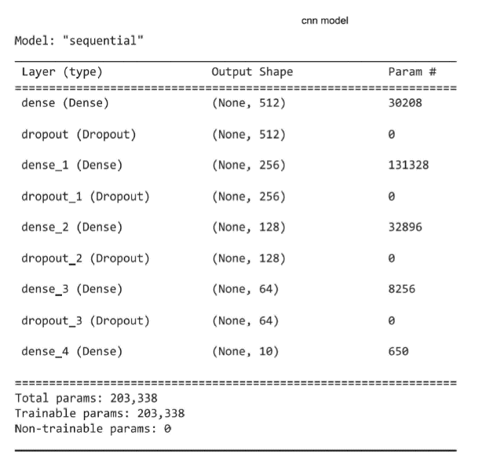
Result
Model Training

Slide 26
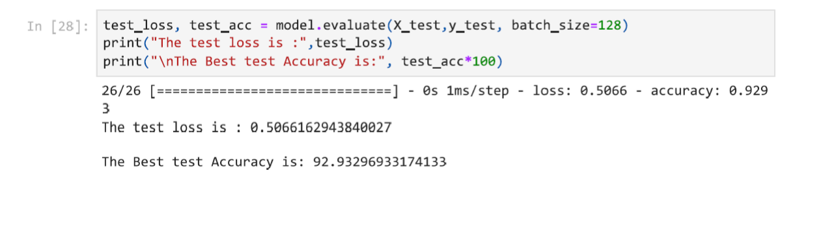
Result
Model Evaluation:

Slide 27

Conclusion
In general, the process of genre classification involves extracting features from a piece of music, such as the lyrics, instrumentation, and tempo, and then using those features to predict the genre label. Machine learning models can be trained on labeled music samples to learn how to classify music based on these features.
To build a successful music genre classification system, it is important to have a diverse and representative dataset, carefully select and extract relevant features, and choose an appropriate machine learning model. The system should also be designed to be scalable, reliable, and secure, and should be tested and evaluated to ensure that it performs well.

Slide 28

References
[1] Lee, D., & Kim, J. (2008). Music genre classification using support vector machines. Expert Systems with Applications, 35(4), 1450-1454.
[2] Music Genre Classification and Recommendation by Using Machine Learning Techniques, Ahmet Elbir Nizamettin Aydin, (2018) Innovations in Intelligent Systems and Applications Conference (ASYU)
[3] Polato, M., & Carvalho, E. (2016). Music genre classification using random forests. In Proceedings of the 23rd International Conference on Pattern Recognition (pp. 3155-3160).
[4] Jannach, D., & Zanker, M. (2004). Music genre classification using decision trees. In Proceedings of the 2nd International Conference on Music Information Retrieval (pp. 227-232).
[5] Improve Music Genre Classification with Conv Nets, Rafael L. Aguiar ; Yandre M.G. Costa ; Carlos (2012).

Slide 29
References
[6] Hareesh Bahuleyan. Music genre classification using machine learning techniques. CoRR, abs/1804.01149 , 2018.
[7] A N-Gram Based Musicological Approach, Eve Zheng ; Melody Moh ; Teng- Sheng Moh, 2017 IEEE 7th International Advance Computing Conference
[8] F. Pedregosa, G. Varoquaux, A. Gramfort, V. Michel, B. Thirion, and E. Duchesnay. Scikit-learn: Machine learning in Python. Journal of Machine Learning Research, 12:2825–2830, 2011.
[9] Pons, J., & Serra, X. (2016). Automatic music genre classification using convolutional neural networks. arXiv preprint arXiv:1608.04363
[10] Changsheng Xu, Namunu C Maddage, Xi Shao, Fang Cao, Qi Tian2003 IEEE International Conference on Acoustics, Speech, and Signal Processing Proceedings.(ICASSP'03). 5, V-429, (2003).

Slide 30
Thank You

